Slide 1
Fabric security: everything you need to know!

Slide 2
PLEASE DO NOT COPY THIS SLIDE. THERE WILL BE MANY UPDATES IN THE NEXT FEW MONTHS AND IT IS IMPORTANT TO STAY UP TO DATE.
Please make sure you update regularly.

Slide 3
For all the latest security related information please visit:
https://aka.ms/MSFabricSecurity

Slide 4
Agenda
Intro to Fabric as a SaaS platform
Authentication to Fabric
Network protection (Entra & Private Link)
Connecting to secure data
Data encryption
Item level security
Data residency
Data Governance and compliance

Slide 5
A world awash with data…

Slide 6
How do you translate data into
competitive advantage?
Notes:
Menu for core section on this slide

Slide 7
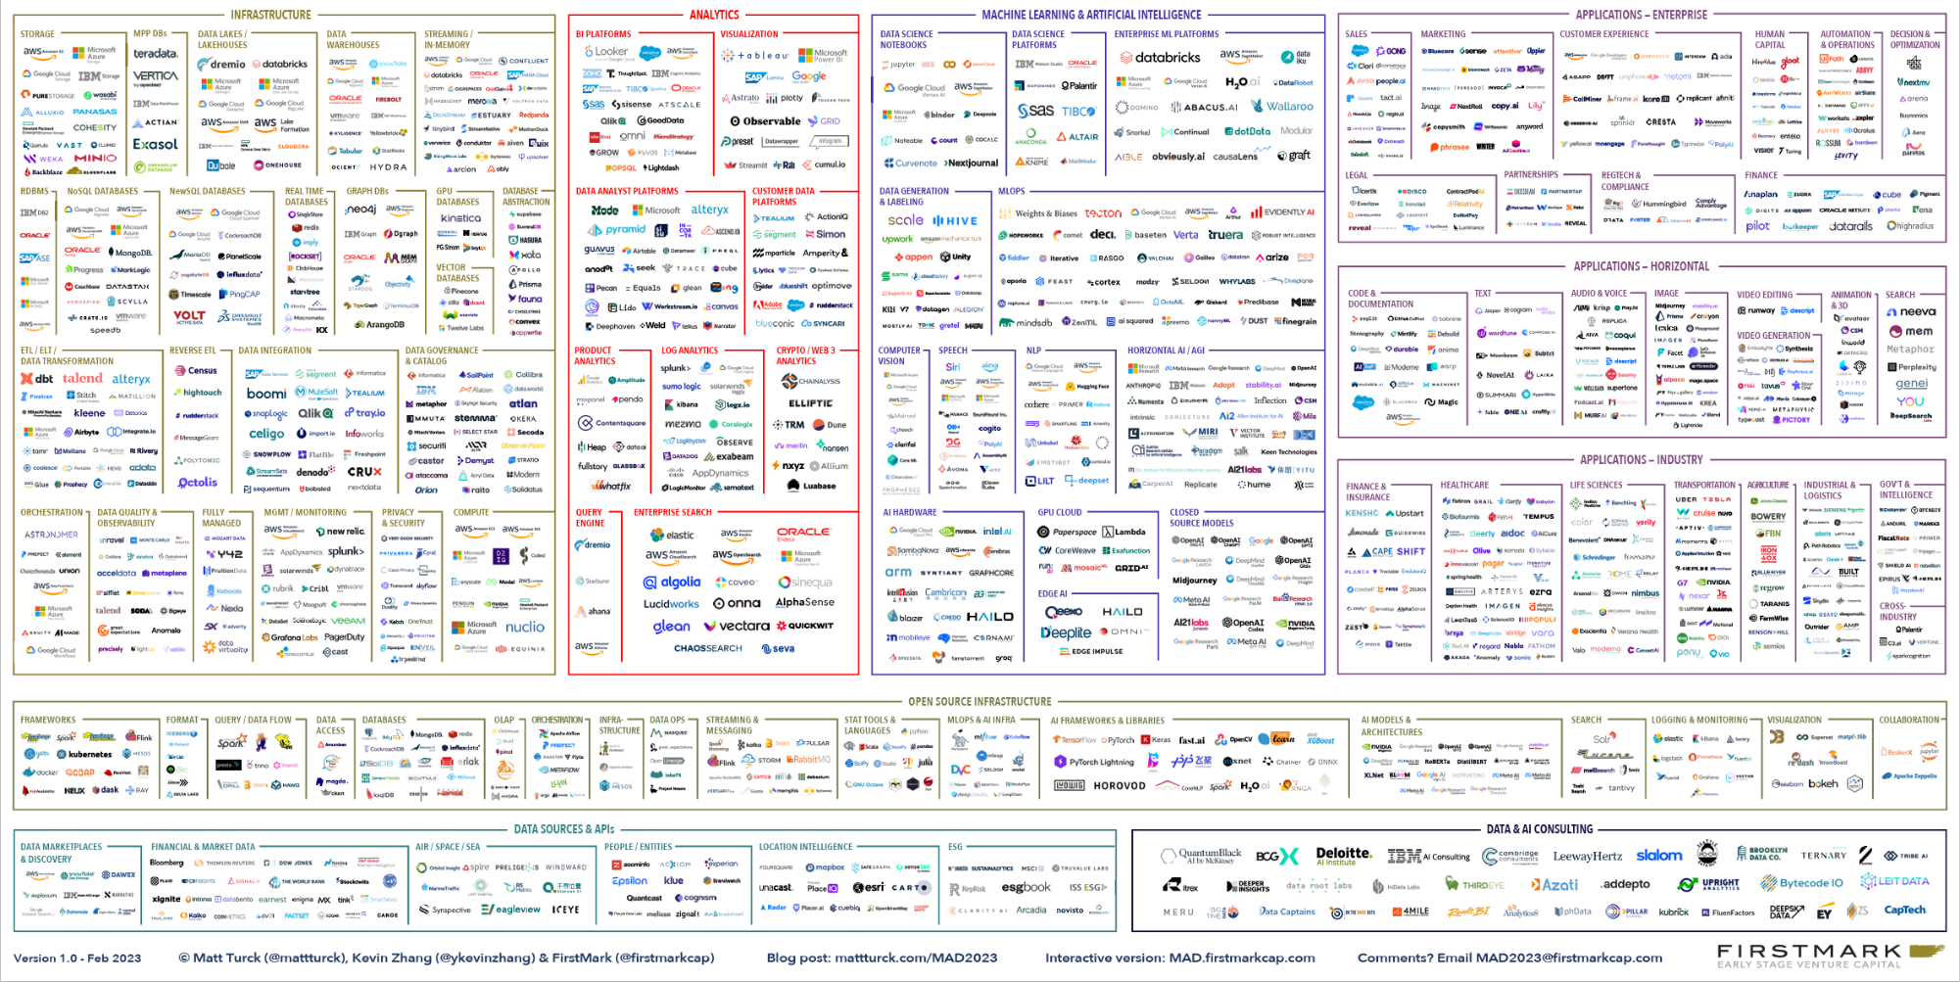
The 2023 ML, AI, and Data Landscape

Slide 8
“
Simplify, I am the Chief Data Officer and don’t want to be the Chief Integration Officer.”
Every CDO, Every Enterprise

Slide 9

Microsoft Fabric
Data analytics for the era of AI
Complete Analytics Platform
Unified product, experience, and architecture
Delivered as SaaS
Notes:
Microsoft Fabric accelerates data potential for the era for AI.
Fabric provides a unified intelligent data foundation for all analytics workloads and integrates Power BI, Data Factory and the next generation of Synapse to offer customers a price performant and easy to manage modern analytics solution
Every analytics workload works seamlessly with OneLake to minimize data management time and effort by eliminating data movement and duplication
Fabric reduces the pain of Factory and facilitates better collaboration with a solution that makes it easy to connect and use the different analytics tools your team needs

Slide 10
Microsoft Fabric
Data analytics for the era of AI
Complete Analytics Platform
Lake Centric and Open
Unified product, experience, and architecture
Delivered as SaaS
Common SaaS data lake shared by all compute engines
Deep commitment for open formats and APIs
Notes:
Microsoft Fabric accelerates data potential for the era for AI.
Fabric provides a unified intelligent data foundation for all analytics workloads and integrates Power BI, Data Factory and the next generation of Synapse to offer customers a price performant and easy to manage modern analytics solution
Every analytics workload works seamlessly with OneLake to minimize data management time and effort by eliminating data movement and duplication
Fabric reduces the pain of Factory and facilitates better collaboration with a solution that makes it easy to connect and use the different analytics tools your team needs

Slide 11








Microsoft Fabric
The unified data platform for the era of AI
Data
Factory
Synapse Data
Engineering
Synapse Data
Science
Synapse Data Warehousing
Synapse Real
Time Analytics
Power BI
Data Activator
OneLake
Notes:
Fabric provides a unified intelligent data foundation for all analytics workloads and integrates Power BI, Data Factory and the next generation of Synapse to offer customers a price performant and easy to manage, modern analytics solution. It is a single SaaS service so you don’t have to worry about setting up a VM or spin anything up. Microsoft will take care of it.

Slide 12
Microsoft Fabric
End-to-end analytics data fabric
From the data lake to the business user
Complete Analytics Platform
Everything, Best of Breed
Unified
Azure OpenAI Copilots
Lake centric and open
OneLake
One Copy
Always Synced
Empower Every Office User
Familiar and intuitive
Built into Office
Insight to action
Pervasive security and governance
End to end visibility
Always governed
Secure by default

Slide 13
Microsoft Fabric
Pervasive Security and Governance
for the cloud world
Complete Analytics Platform
Best of Breed
SaaS-ification
Low Code Plus Pro Dev
Lake Centric and Open
One Lake
One Copy
Always Synced
Empower Every Office User
Familiar and Intuitive
Built into Office
Insight to Action
Pervasive Security and Governance
Secure by Default
End to End Visibility
Always Governed

Slide 14
Modern data challenges
Bring data to the masses, everyone should have access to data to make decisions
Instant access to the latest data, no copying around
Modern workforce, anywhere, any device
At the same time, you need to secure, govern and audit your data to protect customers and the company
SaaS platforms are designed with these challenges in mind.
Shift from siloed PaaS to integrated SaaS
Notes:
Fabric provides a unified intelligent data foundation for all analytics workloads and integrates Power BI, Data Factory and the next generation of Synapse to offer customers a price performant and easy to manage, modern analytics solution. It is a single SaaS service so you don’t have to worry about setting up a VM or spin anything up. Microsoft will take care of it.

Slide 15
Common network security requirements
Need to be able to connect to data inside a firewall\private link from Fabric (outbound)
Inbound protection (restrict inbound by network location)
Secure access to the “backend services”
More stringent customers (FSI\HLS):
Traffic needs to be private (not via public internet)
Endpoints should not be open to the public internet
Notes:
Fabric provides a unified intelligent data foundation for all analytics workloads and integrates Power BI, Data Factory and the next generation of Synapse to offer customers a price performant and easy to manage, modern analytics solution. It is a single SaaS service so you don’t have to worry about setting up a VM or spin anything up. Microsoft will take care of it.

Slide 16







Existing PaaS World
Synapse
PaaS services are disconnected from the Public internet.
FIREWALL
Public Internet
Business
Customer VNet
All communications between the services are configured to go through private endpoint
Data Sources
Private Endpoint
Developers
Data is moved out or through GW
Developers connect to a VPN and connect to the backend services
On-premises data gateway
Private Endpoint
Power BI
Self-Hosted Integration Runtime
Data sources are connected through the self-hosted runtime inside the firewall
When the CEO access the data in Power BI Report, the data is imported into Power BI or through the GW with DQ.
Public Internet
Public Internet
ADF
Storage Account (ADLS)

Slide 17

Microsoft Fabric – SaaS World
Entra ID
Business
Developers
Users connect to the SaaS service from global network
Data
Factory
Synapse Data
Engineering
Synapse Data
Science
Synapse Data Warehousing
Synapse Real Time Analytics
Power BI
Data Activator
Endpoints and access are protected using Entra ID
All internal communications between the experiences happens through MS backbone network
OneLake
When the CEO access the data in Power BI Report, the data is fetched directly from the OneLake instantly and securely without copying or moving
Intelligent data foundation

Slide 18
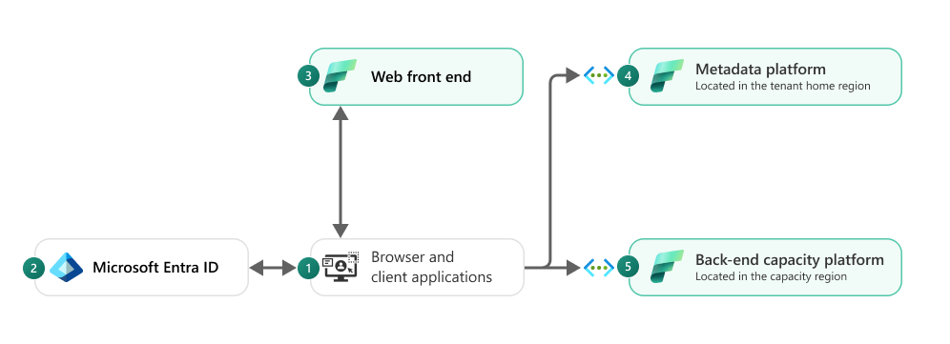
Microsoft Fabric Architecture
Fabrics is built as a SaaS product.
Users connect only to “Front End Services” and we are using “Entra ID” to authenticate and trust all requests.
All the clusters are protected behind “back-end services” and v-nets.
Traffic between experiences is going over MS backend network
Traffic to Fabric will be using at least TLS 1.2
Notes:
Fabric is a SaaS Service.
Users connect only to “Front End Services” and we are using “Entra ID” to authenticate and trust all requests.
All the clusters are protected behind “back-end services”.

Slide 19
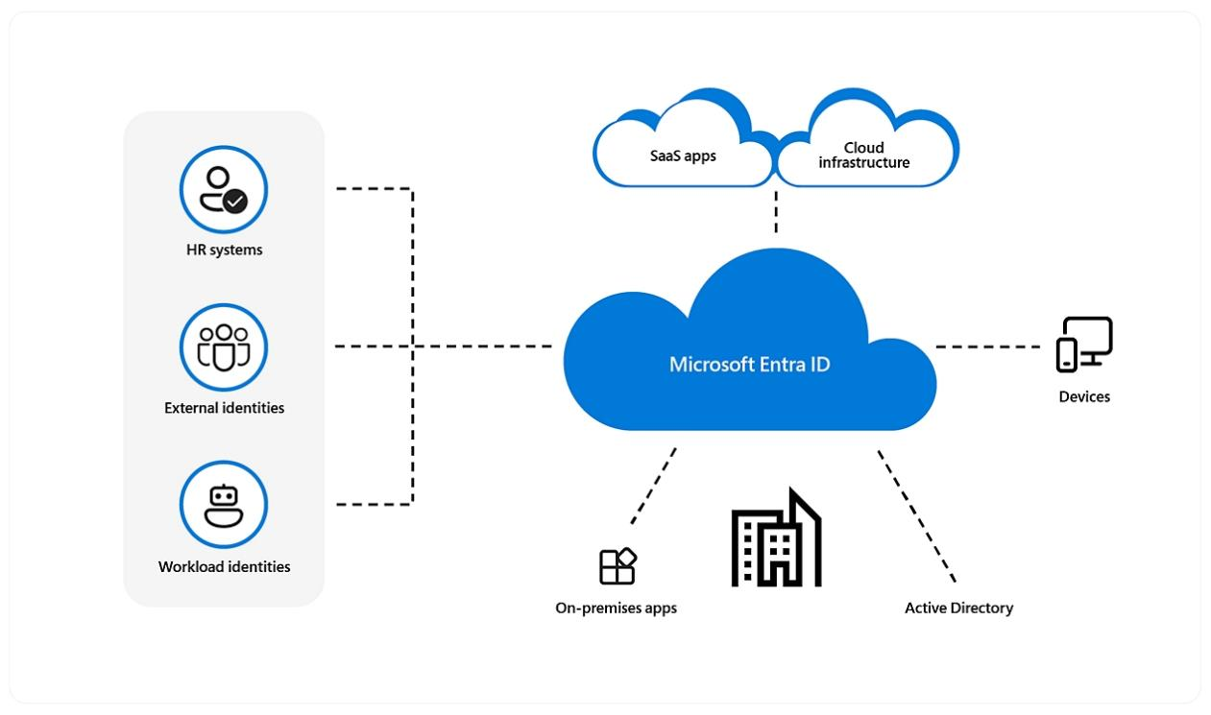
Authentication
Microsoft Entra ID at the hearth of your security
Notes:
The way people work has changed. Instead of working in traditional offices, people now work from nearly anywhere. With applications and data moving to the cloud, an identity-aware, cloud-delivered network perimeter for the modern workforce is needed. Microsoft Entra is the central gate keeper for all incoming requests to Fabric and nothing bypasses Entra. So it makes a lot of sense to combine identity and perimeter security at one place using an Entra feature called Conditional Access.

Slide 20
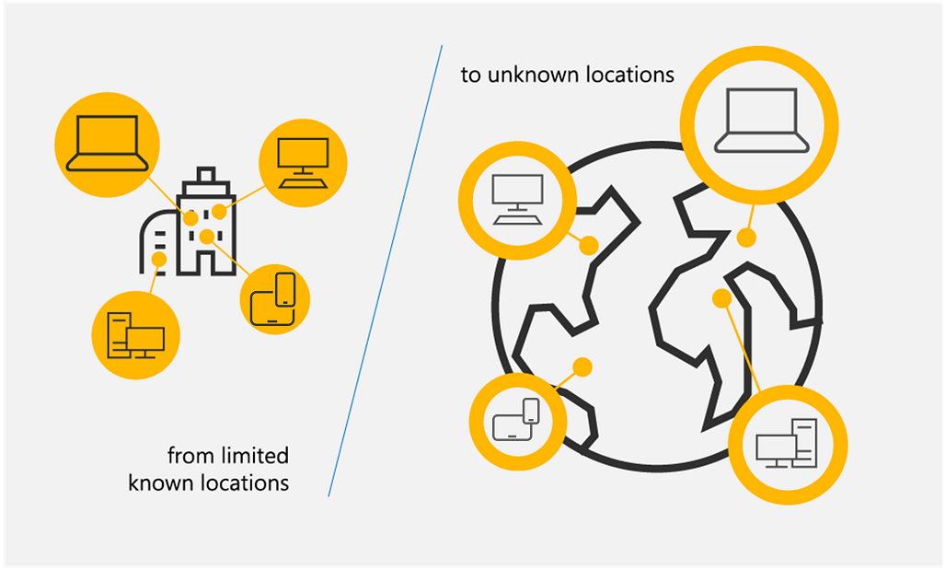
Inbound protection options
Perimeter Network Security
Zero Trust Approach
Notes:
Traditional network security approaches that use legacy VPNs simply cannot scale to modern demands. Once your remote users connect to your corporate network through VPN, they are granted excessive access to your entire network, all it takes is a single compromised user account, infected device, or open port for an attacker to gain entry, move laterally, and access your most critical assets.

Slide 21
Securing inbound connections
Using Zero Trust with Entra CA

Slide 22







New principles for Zero Trust in today’s reality
Verify explicitly
Use least privilege access
Assume breach

Slide 23

Fabric leverages Entra ID for secure adaptive access
Protect access to resources and data with strong authentication and risk-based access policies
User-friendly multifactor authentication (MFA) and Passwordless authentication support
Configurable Conditional Access policies based on context and risk assessment ¹
User and entity behavior analytics (UEBA) to automatically protect against identity compromise ²
¹Microsoft Entra ID P1 \ E3 license required
²Microsoft Entra ID P2 \ E5 license required
Notes:
Talk Track:
Is your end user authentication seamless and secure?
How much control do you have over access?
How do you secure identities against current and emerging threats?
So, our approach in identity and access management is really threefold:
secure authentication that is convenient for end-users
Conditional access to reach Zero trust
Identity protection - safeguard those identities when they are used as part of an OS session or application session.
The first question to ask yourself is, can I make my access protection stronger while also making things easier for users? This is about how people sign in, how often they have to sign in, and how we authenticate that they are who they say they are.
We find that across all of our analytics, that the proper application of a username and password is not a tremendous predictor of a genuinely authenticated person. In other words, just knowing the username and password doesn't prove that I am who I say I am. How can we improve that? How can we get to a world that's beyond passwords, beyond what we know are faulted technology for proving authentication, and at the same time make it easier for end users?
The second question is, how much control do you really have over access? Not only who is accessing what but also, can those access control policies change depending on the conditions?
So, for example, I might be a very trustworthy employee of Microsoft today, and I might be allowed to access certain sensitive information. Tomorrow, I might be a slightly less trustworthy employee, for a variety of reasons we'll get into in a moment, and I might not be allowed to access that same information. Can your access control policies adapt to those changing conditions? Can you make decisions on the fly? This is a technique being championed by many industry experts and analysts.
Some analysts refer to this as adaptive security. The identity space is the primary control point for such a capability.
And then lastly, we ask, how do you protect user credentials? This is really about, in this imperfect world where we do sometimes rely on username and password, keeping those credentials protected once they're used. So that when they're stored as part of an operating system session for example, that they can't be hijacked by an attacker and then used to access other things that the genuine legitimate user is not trying to access.
Microsoft Entra Plans and Pricing | Microsoft Security
EMS Overview
© 2014 Microsoft Corporation. All rights reserved. Microsoft, Windows, Surface and other product names are or may be registered trademarks and/or trademarks in the U.S. and/or other countries. The information herein is for informational purposes only and represents the current view of Microsoft Corporation as of the date of this presentation. Because Microsoft must respond to changing market conditions, it should not be interpreted to be a commitment on the part of Microsoft, and Microsoft cannot guarantee the accuracy of any information provided after the date of this presentation. MICROSOFT MAKES NO WARRANTIES, EXPRESS, IMPLIED OR STATUTORY, AS TO THE INFORMATION IN THIS PRESENTATION.
4/25/2024
23

Slide 24








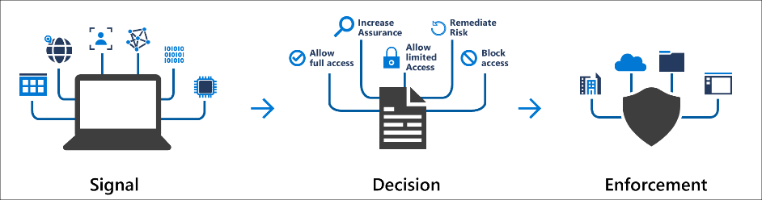
Conditional Access Policies
Common Decisions – Block, Grant, Require MFA
Users and Groups
Network Location
Entra Conditional Access Policies
OneLake
Inbound
Microsoft Fabric
Applications
Devices
Notes:
Microsoft Entra Conditional Access brings signals together, to make decisions, and enforce organizational policies.
Common Signals – Users, Devices and Locations
Common Decisions – Block, Grant, Require MFA
Conditional Access policies at their simplest are if-then statements; if a user wants to access a resource, then they must complete an action. For example: If a user wants to access an application or service like Microsoft 365, then they must perform multifactor authentication to gain access.

Slide 25
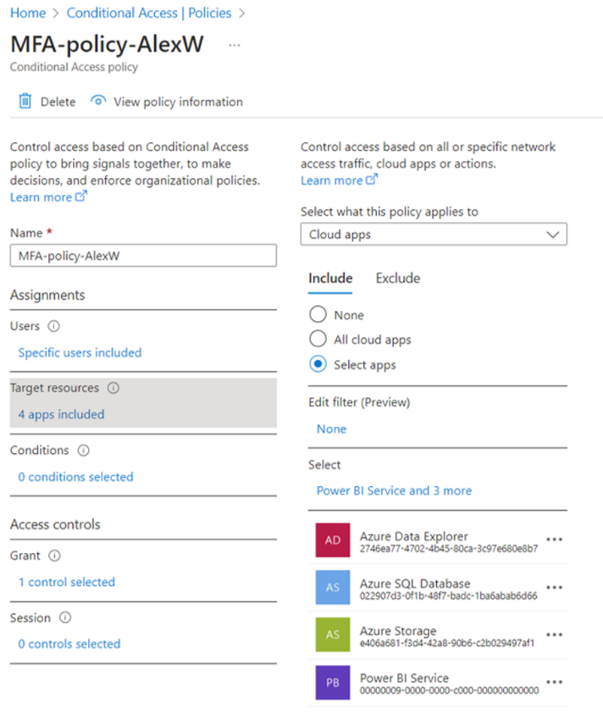
Setting up Conditional Access for Fabric​
Example
Configure a single, common, conditional access policy for Power BI Service, Azure Storage, Azure SQL Database, and Azure Data Explorer.
Configure a conditional access policy that combines IP location, device type, user identity, and much more to allow/deny access to Fabric, or challenge with MFA.
Refer to our Fabric documentation to learn more:
Conditional access - Microsoft Fabric | Microsoft Learn
Notes:
Configure a single, common, conditional access policy for the Power BI Service, Azure Storage, Azure SQL Database, Azure Data Explorer, and Microsoft Azure Management.
Having a single, common policy will significantly reduce unexpected prompts that may arise from different policies being applied to downstream services, and the consistent security posture will provide the best user experience in Microsoft Fabric and its related products.
The products to include in the policy are the following:
Power BI Service
Azure Data Explorer
Azure SQL Database
Azure Storage

Slide 26
Securing inbound connections
using Private Links

Slide 27
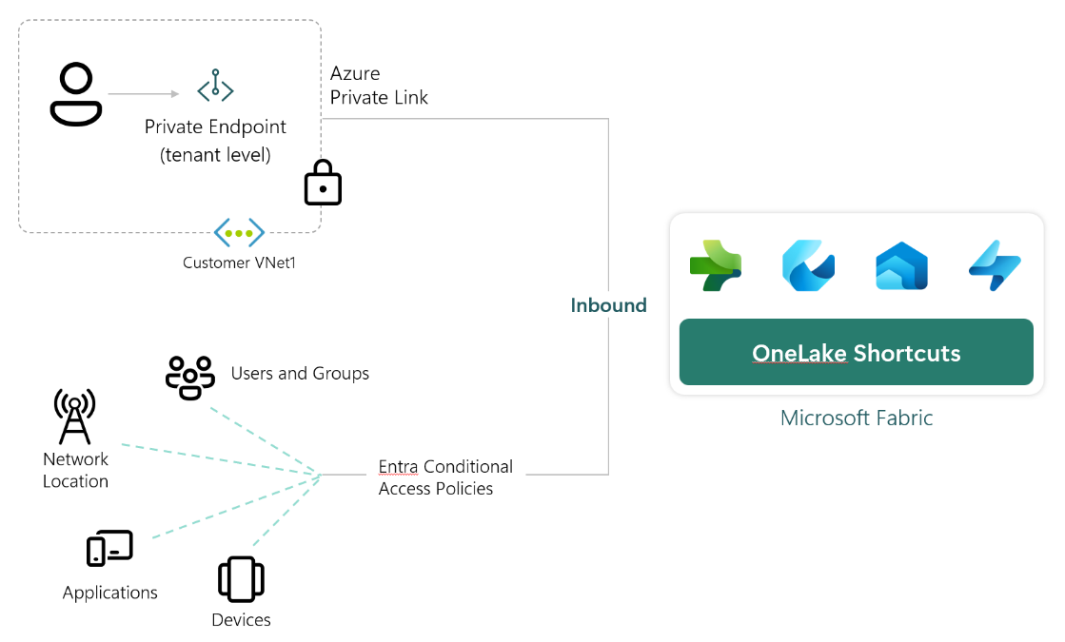
Private Link for Fabric
Perimeter Network Security for your tenant
What it means:
Fabric is disconnected from the public internet
Every users needs to connect to the private network to get access on every device
No longer able to load resources locally (slower reports)
Increases ExpressRoute bandwidth and added costs for Private Links
Several product limitations (like on-prem data gateway)

Slide 28
Getting secured data
into Fabric

Slide 29
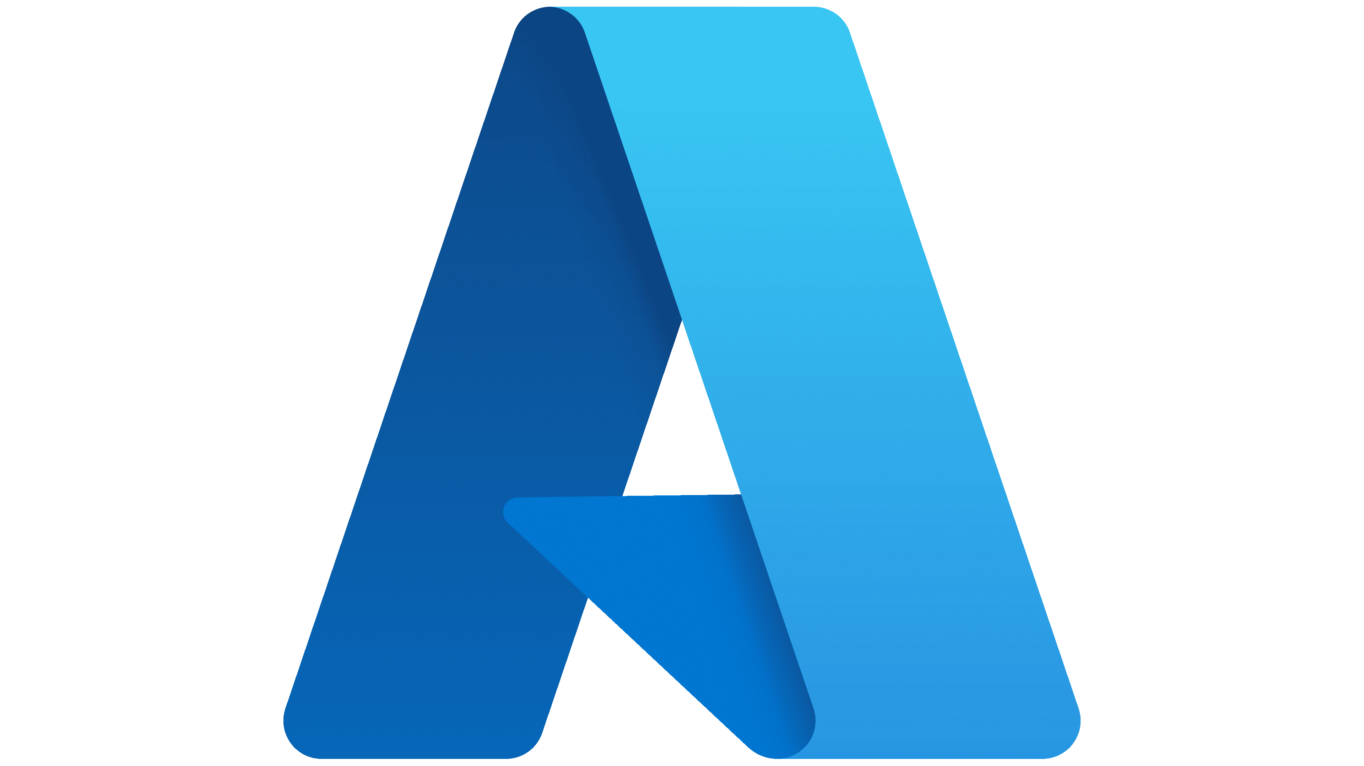









Getting data into Fabric
How to connect/load data in the VNET from Fabric
Azure PaaS
Dataflows Gen2
Fabric Spark
Shortcut to ADLS Gen2
Managed private endpoints
Azure Data
Factory
Azure
Databricks
On-Prem Data Gateway
Trusted Workspace Access
Fabric Pipelines (COPY)
Azure Synapse Analytics (Spark)
VNet Data Gateway
On-Prem Data Gateway

Slide 30
Connect/load data in the VNET from Fabric
Workspace 1
Trusted Access for
Fabric Workspace Identity
Shortcuts
Workspace 2
Shortcuts
Managed Private Endpoint
Inbound
OneLake
Workspace N
Azure Data Lake Storage Gen2
Microsoft Fabric
Customer VNet
Notes:
Fabric will soon be enabled as an Azure trusted service. This will make it possible to connect and use shortcuts to data inside ADLS Gen 2 from Fabric, even when the public access to ADLS is blocked, without having to explicitly allow the Fabric IP addresses in the ADLS firewall rules.
Fabric as a trusted service for Azure Storage
Estimated release timeline: Q1 2024
You'll be able to add the Fabric workspace identity (FWI) as a trusted identity for a storage account. This allows seamless connectivity to Azure Storage accounts secured by a firewall. It also enables traffic using that Fabric workspace identity from the corresponding workspace to connect to the storage account. For instance, the data warehouse COPY command in a specific workspace can connect to a storage account bypassing any firewall rules when the relevant Fabric workspace identity is added as a trusted identity.
On-premises data gateway (OPDG) support added to data pipelines
Estimated release timeline: Q1 2024
This feature will enable data pipelines to use Fabric data gateways to access data that is on-premises and behind a VNet. For users using self-hosted integration runtimes (SHIR), they'll be able to move to on-premises data gateways in Fabric.

Slide 31
Fine-grained security and access controls in Fabric

Slide 32







Multiple layers of security and access control
Platform level access. Authentication through Entra ID. Inbound through Private Link or Conditional access
Microsoft Fabric (SaaS tenant)
Domain
Domain specific configuration. by domain admins
Workspace
Workspace level access. Boundary for managing artifacts. E.g. admin, contributor and viewers.
Artifact
Artifact
Artifact
Artifact
Compute security. e.g. Warehouse access through GRANT/DENY or Semantic Models & Warehouse RLS \ OLS.
OneLake
Item level access. e.g. read all only via OneLake or read access to only subset of data.
More granular roles for files and folders.
Files
Shortcuts
Tables
Tables

Slide 33
Universal security coming later
Platform level access. Authentication through Entra ID. Inbound through Private Link or Conditional access
Microsoft Fabric (SaaS tenant)
Domain
Domain specific configuration. by domain admins
Workspace
Workspace level access. Boundary for managing artifacts. E.g. admin, contributor and viewers.
Artifact
Artifact
Artifact
Artifact
OneLake
Compute level
Universal security: Define security once and propagated to OneLake and every compute engine for access and OLS \ RLS
Item level
Files
Shortcuts
Tables
Tables
OneLake

Slide 34
Data Encryption in Fabric

Slide 35
Encryption in Fabric
Encryption in-transit:
Encryption at-rest:
Transport Layer Security (TLS 1.2) enforced
All endpoints
TDS (SQL) (TLS 1.2)
XMLA (HTTPS)
OneLake (ABFSS)
APIs (HTTPS)
All internal communications are encrypted in transit
All data encrypted at rest
Customer data, metadata, caches
Platform managed keys – secure, convenient and low overhead
BitLocker encryption wherever applicable
Notes:
Azure Encryption Overview: Azure encryption overview | Microsoft Learn

Slide 36
Data Residency and Compliance.

Slide 37

Data Residency
With the largest global footprint, Fabric multi-geo capacities allows control over content storage location in one of 54 data centers world-wide

Slide 38
OneLake which logically spans the world
Unified management and governance
Workspaces can reside in different regions around the world while still being part of the same data lake.
OneLake
Workspace
POS sales
Workspace online sales
Workspace
customer
Workspace
ads
Workspace
expenses
Notes:
You might be thinking that your organization can’t have just one lake because you are in multiple countries, and you have requirements that data must reside in those countries. OneLake covers this this by spanning the globe as well. Different workspace can reside in different regions. This means that any data in those workspaces will also reside in those countries. OneLake is built on top of Azure Data Lake Store gen2. Under the covers, it may use multiple storage accounts in different regions however, OneLake will virtualize them into one logical lake.

Slide 39






Compliance with Microsoft Fabric
Microsoft Fabric is a core Microsoft online service and supports a wide range of compliance standards including:
GDPR
EUDB
ISO certifications including ISO 27001, 27701, 27017, 27018
HIPAA compliance
Other certifications will continue to be available…
Notes:
Workspace security
Workspaces represent the primary security boundary for data stored in OneLake. Each workspace represents a single domain or project area where teams can collaborate on data. You manage security in the workspace by assigning users to workspace roles.
For more information, see OneLake security (Workspace security).
Item security
Within a workspace, you can assign permissions directly to Fabric items, like warehouses and lakehouses. Item security provides the flexibility to grant access to an individual Fabric item without granting access to the entire workspace. Users can set up per-item permissions either by sharing an item or by managing the permissions of an item.
For information, see OneLake security (Item security).

Slide 40
Administration and governance

Slide 41
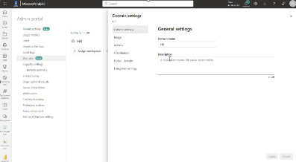
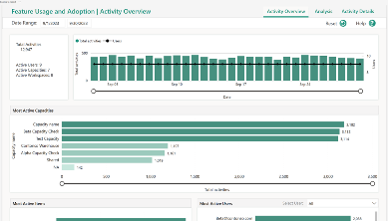
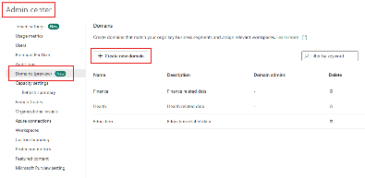
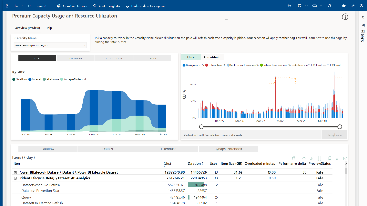


Admin and Monitor activity across your tenant
Delegated admin permission
Admin monitoring & auditing
Admin monitoring
Capacity metrics
Monitoring hub
Capacity metrics
Provide delegated admin permissions per Domain and Capacity
Uncover insights for effective governance with reports and datasets built for admins. Log, view and export user activities from Microsoft Fabric to support auditing
Uncover insights for effective governance with pre-built reports and datasets built for admins
Monitor Fabric activities, such as semantic model refresh and Spark Job runs and many others, from a central location
Gain visibility into capacity utilization and usage trends with daily aggregation so you can plan and scale your capacity accordingly
Gain visibility into capacity utilization and usage trends with daily aggregation so you can plan and scale your capacity accordingly
…

Slide 42
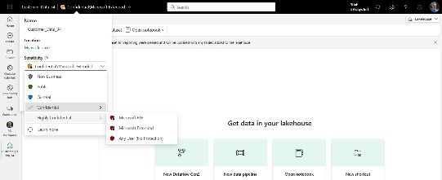
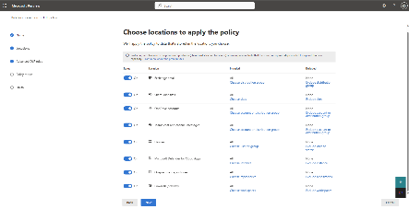
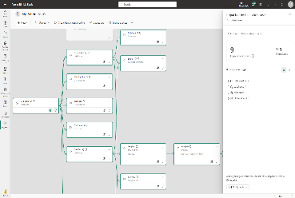




Security and compliance features
Secure and protect data across your organization
Information Protection labels*
Data Loss Prevention policies*
Metadata & Lineage
Classify sensitive Fabric data using the same sensitivity labels that are used in Microsoft 365—enforced even when the data is exported
Automatically detect the upload of sensitive data such as PII and trigger automatic risk remediation actions such as alerts
See lineage view of analytical projects to see how data flows through items and perform impact analysis to assess impact of changes.
Can be extended with Purview Data Map and Scanner API’s
…
*Additional Microsoft Purview purchase required

Slide 43
Thank you

